Slide 1
L’algorithme breveté (ccmmande B) apliqueé aux drones
David Bensoussan

Slide 2
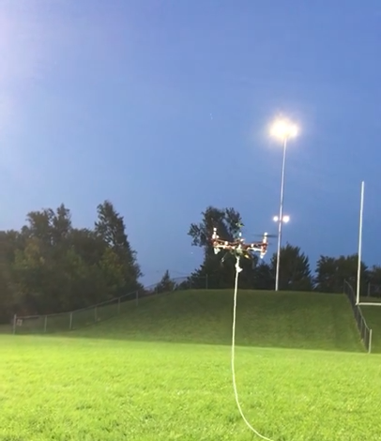
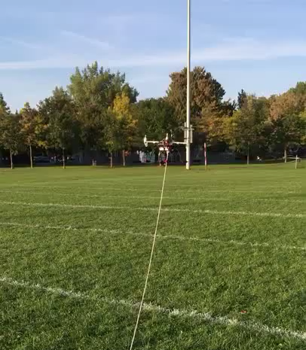

B Control vs Manufacturer’s PID Controller
https://www.youtube.com/watch?v=T4OzCX0huKY (manufacturer)
https://www.youtube.com/watch?v=lDfSQJ5x1DM (our control)

Slide 3
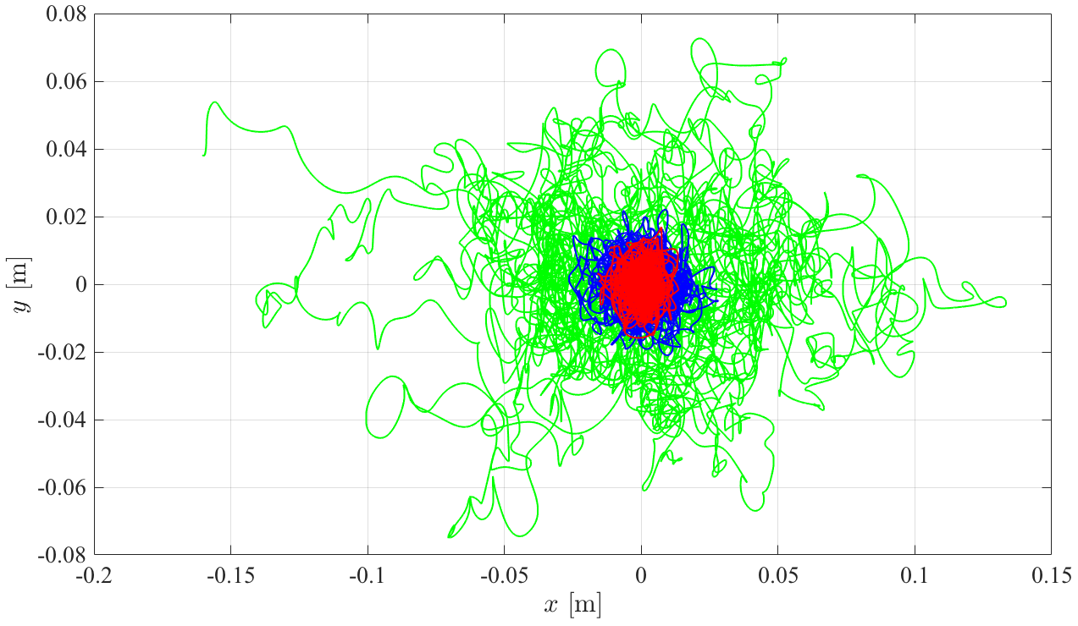
Steady flight in windy conditions
Stabilité du drone compare aux meilleures méthodes de commande
Variations on the x, y axis for steady flight in windy conditions :
B (red), H₂ (green), H∞ (blue)

